Slide 1
Program IO and Interrupt
Program-controlled IO (polling)
Interrupt Driven I/O
Handling multiple devices
PIC18 Interrupt example

Slide 2
Program IO and Interrupt
Program-controlled IO (polling)
Interrupt Driven I/O
Handling multiple devices
PIC18 Interrupt example

Slide 3
Program-controlled IO
Consider a computer system
If a key is pressed,
Datain Reg contains the new key.
Status Register is set.
3
Notes:
3

Slide 4
Program-controlled IO
Since the speed of the CPU and the speed of the human operator are different. However, we must ensure that an instruction to read character from the keyboard is executed only when a character is available in the input buffer of the keyboard interface. We must also ensure that an input character is read only once.
Consider the following Pseudocode:
WAIT_key Read STATUS
Test STATUS
if no new character, Jump WAIT_key
Read DATAIN
4
Notes:
4

Slide 5
Program-controlled IO (polling)
WAIT_key: Read STATUS
Test STATUS
if no new character, Jump WAIT_key
Read DATAIN
In program controlled IO, the CPU repeatedly checks a status flag to achieve the required synchronization between the CPU and the input device. The programs enters a wait loop in which it repeatedly tests the device status. During this period, the CPU is not performing any useful computation.
5
Notes:
5

Slide 6
Program IO and Interrupt
Program-controlled IO (polling)
Interrupt Driven I/O
Handling multiple devices
Direct Memory Access
PIC18 Interrupt example

Slide 7
Interrupt Driven I/O
In many situations, other tasks can be performed while the CPU waits for an IO device to become ready. To do this, we can arrange for the IO device to alert the CPU when it is ready. It does so by sending a hardware signal called an interrupt.
The CPU allows normal program execution to be interrupted by some external signals from I/O devices.
When interrupted, it stops executing its current program and enter an interrupt sequence. The status of the current program is saved before entering the interrupt service routine (ISR) that services the interrupt.
After servicing the interrupt, the status before the interrupt is restored, execution is then returned to the interrupted program.
7
Notes:
7

Slide 8
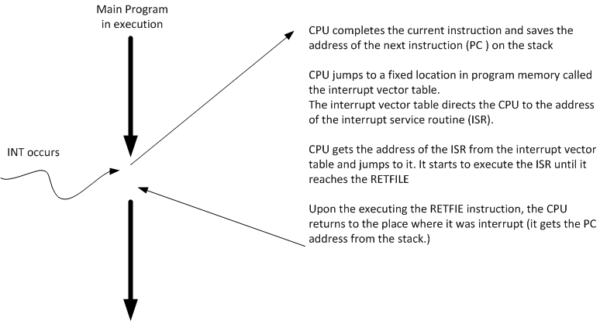
Interrupt Driven I/O
8
Notes:
8

Slide 9
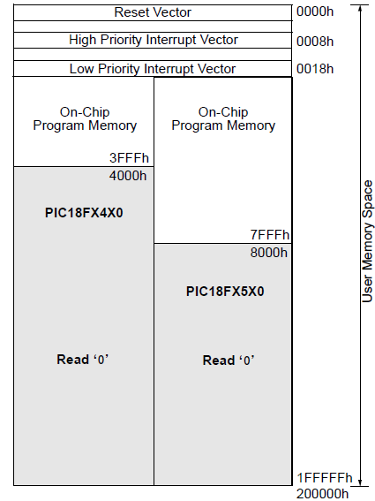
Interrupt Driven I/O
When an interrupt is invoked the uC runs the Interrupt Service Routine(ISR)
Interrupt vector table holds the address of ISRs
Power-on Reset 0000h
High priority interrupt 0008h
Low priority interrupt 0018h
9
Notes:
9

Slide 10
Steps in executing an interrupt
Upon activation of interrupt the microcontroller
Finishes executing the current instruction
Pushes the PC of next instruction in the stack
Jumps to the interrupt vector table to get the address of ISR and jumps to it
Begin executing the ISR instructions to the last instruction of ISR (RETFIE)
Executes RETFIE
Pops the PC from the stack
Starts to execute from the address of that PC

Slide 11
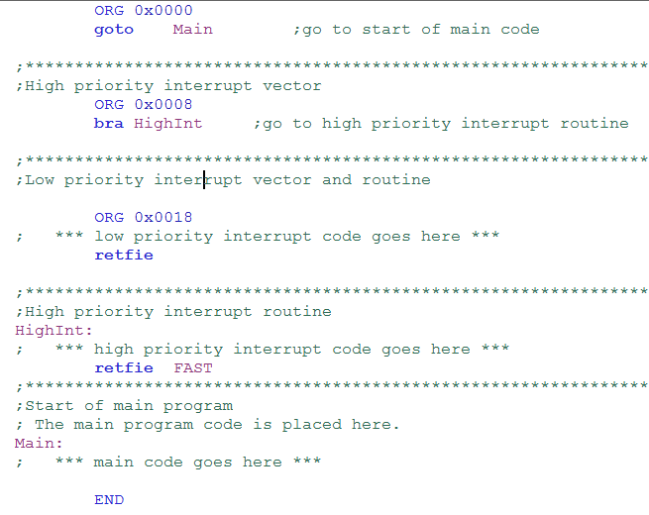
Program organization in MPLAB

Slide 12
Sources of interrupts in PIC18
External hardware interrupts
Pins RB0(INT0),RB1(INT1),RB2(INT2)
PORTB change
Timers
Timer0 , Timer1 ,Timer2
ADC (analog to digital converter)
CCP (compare capture pulse width modulation, PWM)
... etc

Slide 13
Enabling and disabling an interrupt
When the PIC is powered on (or resets)
All interrupts are masked (disabled)
The default ISR address is 0008h
No interrupt priorities for interrupts

Slide 14
Program IO and Interrupt
Program-controlled IO (polling)
Interrupt Driven I/O
Handling multiple devices
Direct Memory Access
PIC18 Interrupt example

Slide 15
Handling multiple devices
If there are multiple interrupt lines and each of lines is corresponding to an interrupt routine. So, if INTR i is activated, the CPU will jump to the i-INTR routine. The above scheme is called as multiple interrupt line.
In many cases, several devices capable of initiating interrupts are connected to the CPU, or several interrupts use the same interrupt service routine.
15
Notes:
15

Slide 16
Handling multiple devices
Questions:
How can the CPU recognize the device requesting an interrupt?
How can the processor obtain the starting address of the appropriate routine?
Should a device be allowed to interrupt the CPU while another interrupt is being serviced?
How should two or more simultaneous interrupt request be handled?
16
Notes:
16

Slide 17
Device identification by program polling
When a request is received over a common INTR line, additional information is needed to identify the particular device that activated the line. The information is provided in the status in the status registers of the devices.
The interrupt-service routine begins by polling the devices (check interrupt request bit of the status registers of the devices) in some orders. The first device encountered with its IRQ bit set is the device that is serviced, and an appropriate subroutine is called to provide the requested service.
Device identification by program polling
17
Notes:
17

Slide 18
Device identification by program polling
Polling interrupt service routine
if IRQ of device A set, jump to serve device A routine.
if IRQ of device B set, jump to serve device B routine.
::::::::::::::::::::::
::::::::::::::::::::::
Advantage : simple and easy to implement.
Disadvantage: time spent interrogating the IRQ bits of all the devices.
18
Notes:
18

Slide 19
Vectored Interrupts
A device requesting an interrupt can identify its self by sending a special code to the CPU over the data bus.
The CPU gets the address of the corresponding interrupt service from a vector table based on the code.
The CPU will jump to the corresponding interrupt service.
NOT ALL CPUs have this mechanism.
8051 does not have
PIC18 does not have
68000 family do have
19
Notes:
19

Slide 20
Priority of Interruptss
IO devices, or interrupts are organized in a priority structure. An interrupt request with a high priority should be accepted while the CPU is servicing another request from a low-priority device.
A real time clock interrupt should be high priority than a read key interrupt.
Priority of P18 interrupts
In PIC18, we can configure some bits in control word registers to set the priority of an interrupt.
INTERRUPT | PRIORITY
High Priority Interrupt | High
Low Priority Interrupt | Low
20
Notes:
20

Slide 21
Priority of Interruptss
Each INTR line is assigned a different priority level.
Interrupt requests received over these lines are sent to a priority arbitration circuit in the CPU (or a external circuit).
A request is accepted only if
1. It has a higher priority than other interrupts that are being served or there is not interrupt that are being served.
2. The corresponding interrupt enable pin is enable
21
Notes:
21

Slide 22
Comparison
QUESTION: Explain the following table
 | program IO | INT
initialize IO | CPU | IO device
overhead | small | large
speed | slow | slow
Response speed | slow | fast
22
Notes:
22

Slide 23
Program IO and Interrupt
Program-controlled IO (polling)
Interrupt Driven I/O
Handling multiple devices
Direct Memory Access
PIC18 Interrupt example

Slide 24
Sources of interrupts in PIC18
External hardware interrupts
Pins RB0(INT0),RB1(INT1),RB2(INT2)
PORTB change
Timers
Timer0 , Timer1 ,Timer2
ADC (analog to digital converter)
CCP (compare capture pulse width modulation, PWM)
... etc

Slide 25
Additional Notes
When INT occurs
Finishes executing the current instruction
Pushes the PC of next instruction in the stack
Jumps to the interrupt vector table to get the address of ISR and jumps to it.
Disable GIE (automatically)
Begin executing the ISR instructions to the last instruction of ISR (RETFIE)
Executes RETFIE
Pops the PC from the stack
Set GEIE
Starts to execute from the address of that PC

Slide 26
Enabling and disabling an interrupt
When the PIC is powered on (or resets)
All interrupts are masked (disabled)
The default ISR address is 0008h
No interrupt priorities for interrupts

Slide 27
Enabling and disabling an interrupt
In general, interrupt sources have three bits to control their operation. They are:
Flag bit
to indicate that an interrupt event occurred
Enable bit
that allows program execution to branch to the interrupt vector address when the flag bit is set
Priority bit
to select high priority or low priority

Slide 28
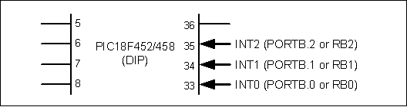
External interrupts INT0, INT1, INT2
INT (pin) | Flag bit Register | Enable bit Register | Pos or Neg Register edge
INT0 (RB0) | INT0IF INTCON | INT0IE INTCON | INTEDGE0 INTCON2
INT1 (RB1) | INT1IF INTCON3 | INT1IE INTCON3 | INTEDGE1 INTCON2
INT2 (RB2) | INT2IF INTCON3 | INT2IE INTCON3 | INTEDGE2 INTCON2
 | Set to 1 by the interrupt event. | 0 enable 1 disable | 0 falling edge 1 rising edge (default power-on

Slide 29
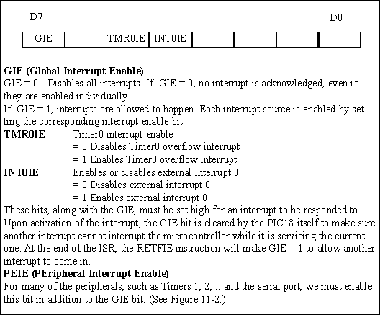
Steps in enabling an interrupt
Set the GIE bit from INTCON REG
Set the IE bit for that interrupt
If the interrupt is one of the peripheral (timers 1,2 , serial,etc ) set PEIE bit from INTCON reg

Slide 30
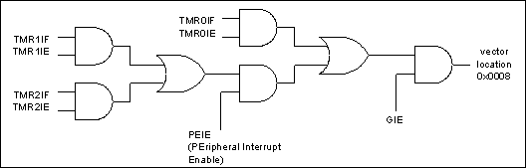
Example
a)
BSF INTCON,TMR0IE
BSF INTCON,INT0IE
BSF INTCON,GIE
Or
MOVLW B’10110000’
MOVWF INTCON
b)
BCF INTCON,TMR0IE
c) BCF INTCON,GIE

Slide 31
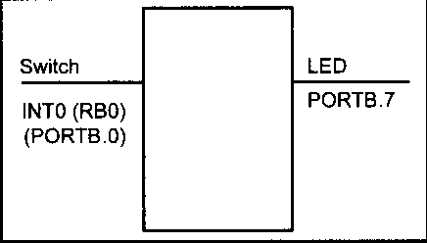
Example
Connect a switch to INT0 and an LED to pin RB7
Every time INT0 is activated, it toggles the LED.
At the same time, data is being transferred from PORTC to PORTD.

Slide 32
Program
ORG 0000H
GOTO MAIN
ORG 0008H
BTFSS INTCON,INT0IF
RETFIE
GOTO INT0_ISR
ORG 00100H
MAIN
BCF TRISB,7
BSF TRISB, 0
CLRF TRISD
SETF TRISC
BCF INTCON,INT0IF
BSF INTCON,INT0IE
BSF INTCON,GIE
OVER MOVFF PORTC, PORTD
BRA OVER
INT0_ISR
ORG 200H
BTG PORTB,7
BCF INTCON,INT0IF
RETFIE
END

Slide 33
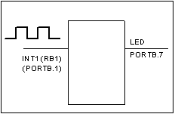
Negative Edge-triggered interrupts
ORG 0000H
GOTO MAIN
ORG 0008H
BTFSS INTCON3,INT1IF
RETFIE
GOTO INT1_ISR
ORG 00100H
MAIN
BCF TRISB,7
BSF TRISB, 1
BSF INTCON3,INT1IE
BCF INTCON3,INT1IF
BCF INTCON2,INTEDGE1
BSF INTCON,GIE
OVER MOVFF PORTC, PORTD
BRA OVER
INT1_ISR
ORG 200H
BTG PORTB,7
BCF INTCON3,INT1IF
RETFIE
END

Slide 34
Sampling the Edge triggered interrupt
The external source must be held high for at least two instruction cycles
For XTAL 10Mhz
Instruction cycle time is 400ns,0.4us
So minimum pulse duration to detect edge triggered interrupts = 2 instruction cycle =
0.8us

Slide 35
Example
Connect a switch to INT0 and another switch to INT1.
Every time INT0 is activated, it increments the content in location 0.
Every time INT1 is activated, it decrements the content in location 0.
At the same time, data is being transferred from PORTC to PORTD.

Slide 36
Example
ORG 0000H
GOTO MAIN
ORG 0008H
BTFSC INTCON,INT0IF
RCALL INT0_ISR
BTFSC INTCON3,INT1IF
RCALL INT1_ISR
RETFIE
ORG 00100H
MAIN
BSF TRISB, 0
BSF TRISB, 1
CLRF TRISD
SETF TRISC
BCF INTCON,INT0IF
BSF INTCON,INT0IE
BCF INTCON2,INTEDGE0
BSF INTCON3,INT1IE
BCF INTCON3,INT1IF
BCF INTCON2,INTEDGE1
BSF INTCON,GIE
OVER MOVFF PORTC, PORTD
BRA OVER
INT0_ISR
INCF 0, F
BCF INTCON,INT0IF
RETURN
INT1_ISR
DECF 0, F
BCF INTCON3,INT1IF
RETURN
END

Slide 37
ORG 0000H
GOTO MAIN
ORG 0008H
GOTO check
ORG 00100H
MAIN
BSF TRISB, 0
BSF TRISB, 1
CLRF TRISD
SETF TRISC
BCF INTCON,INT0IF
BSF INTCON,INT0IE
BCF INTCON2,INTEDGE0
BSF INTCON3,INT1IE
BCF INTCON3,INT1IF
BCF INTCON2,INTEDGE1
BSF INTCON,GIE
OVER MOVFF PORTC, PORTD
BRA OVER
check
BTFSC INTCON,INT0IF
RCALL INT0_ISR
BTFSC INTCON3,INT1IF
RCALL INT1_ISR
RETFIE
INT0_ISR
INCF 0, F
BCF INTCON,INT0IF
RETURN
INT1_ISR
DECF 0, F
BCF INTCON3,INT1IF
RETURN
END

Slide 38
Example
Note that an ISR may change WREG, BSR, and Status register.
If this happens, when the CPU returns from INT, the original information may lost.
How to solve this problem?

Slide 39

PORTB change interrupt

Slide 40
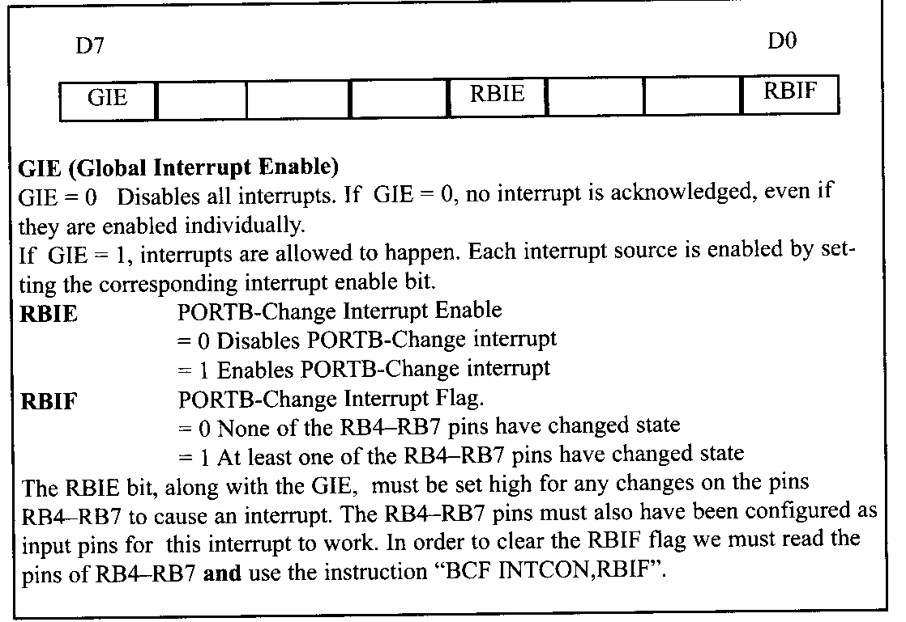
PORTB change interrupt

Slide 41
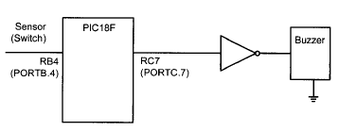
PORTB change interrupt
A door sensor to pin RB4 and a buzzer to pinRC7.
Every time the door is open, it sounds the buzzer by a sending a square wave for a while.

Slide 42
Program
MYREG EQU 0x20
DELRG EQU 0x80
ORG 0000H
GOTO MAIN
ORG 0008H BTFSS INTCON,RBIF RETFIE GOTO PB_ISR
ORG 00100H
MAIN BCF TRISC,7
BSF TRISB,4
BSF INTCON,RBIE
BSF INTCON,GIE
OVER BRA OVER
PB_ISR
ORG 200H
MOVF PORTB,W MOVLW D'250'
MOVWF MYREG
BUZZ BTG PORTC,7 MOVLW D'255'
MOVWF DELRG
DELAY DECF DELRG,F
BNZ DELAY
DECF MYREG,F
BNZ BUZZ
BCF INTCON,RBIF
RETFIE
END

Slide 43
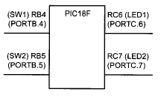
Another Example
SW1 and SW2 to RB4 and R B5 respectively.
Activation of SW1➔ state change in LED

Slide 44
Program
ORG 0000H
GOTO MAIN
ORG 0008H
BTFSS INTCON,RBIF
RETFIE
GOTO PB_ISR
ORG 0100H
MAIN BCF TRISC,4
BCF TRISC,5
BSF TRISB,4
BSF TRISB,5
BSF INTCON,RBIE
BSF INTCON,GIE
OVER BRA OVER
PB_ISR
ORG 200H
MOVFF PORTB,W
ANDLW 0x30
MOVFF W,PORTC
BCF INTCON,RBIF
RETFIE
END

Slide 45
Outcomes
Able to describe the concept of Program-controlled IO.
Able to write a program to control a simple task based on Program-controlled IO.
Able to describe the concept of Interrupt Driven I/O
Able to describe the rationale of the steps in nterrupt Driven I/O
Able to write a program to control a simple task based of Interrupt Driven I/O
.

